Slide 1

Let’s Learn About
Quotation Marks!!!
“
”

Slide 2
?

Slide 3
!

Slide 4
The yellow dog is here,
said Max.

Slide 5
The yellow dog is here,
“
”
said Max.

Slide 6
?

Slide 7
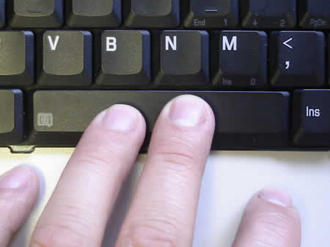
!

Slide 8
I have a gift for you!
“
”
said
Mom.

Slide 9
Can we go play with Tom?
“
”
said Skip.

Slide 10
Hot dogs and jam will not
“
”
be good,
said Jay Jay.

Slide 11
We can run so fast! We
“
run and play in the hot
”
sun,
said the kids.

Slide 12
!
CHALLENGE!!!

Slide 13
Meow.
“
”
The cat said,

Slide 14
